Slide 1

Converging AI and High-Performance Computing for Scalable and Robust Anomaly Detection
DP2E-AI
Dr. Zineb ZIANI
Prof. Nahid EMAD
June 17, 2025

Slide 2
Table of Contents
1. Introduction
2. Approach and Methodology
3. Proposed Anomaly Detection Frameworks
4. Performance Evaluation
5. Conclusion
Notes:
The structure of this thesis starts by

Slide 3
1. Introduction
AI and HPC Convergence
Anomaly detection
Anomaly detection methods
Challenges in anomaly detection
Notes:
In this section I will provide an overview of the context, discuss AD, hilighte the challenges associated with AD, and introduce an ideal AD solution

Slide 4
AI and HPC Convergence
Artificial Intelligence
High Performance Computing
The ability of machines to mimic human cognitive processes, using algorithms and mathematical models
Process data and perform calculations at speeds surpassing regular computers, optimized for large-scale mathematical operations
AI and HPC
Enhances the processing power needed for analyzing massive datasets, enabling advanced solutions like more effective anomaly detection
Notes:
Artificial Intelligence, or AI, refers to the ability of machines to replicate human cognitive processes, such as learning, reasoning, and decision-making. This is achieved through sophisticated algorithms and mathematical models that analyze data to make predictions or solve problems.
High-Performance Computing (HPC), on the other hand, focuses on processing large amounts of data and performing calculations at speeds that far exceed those of conventional computers. HPC is optimized for handling computationally demanding tasks, such as large-scale mathematical operations.
When AI and HPC converge, they unlock transformative possibilities. The immense processing power provided by HPC enables AI to efficiently handle vast datasets, paving the way for advanced solutions like High-Effective Anomaly Detection.

Slide 5
Anomaly Detection
Boosts Safety
Identification of observations exhibiting significant divergence from expected patterns
Improves effectiveness
Manages Risks
Ensures Quality
Context
Disease detection
Fraud detection
Applications Fields
Intrusion detection
Fault detection
. . .

Slide 6
Anomaly Detection Methods
Machine learning methods:
Employ statistical and mathematical algorithms to uncover anomalies or outliers within datasets.
KNN, Clustering, Linear Regression, SVM...
Deep learning methods:
use neural networks with multiple layers to automatically learn complex features and patterns, and require large amounts of unlabeled data.
Autoencoders, GANs, Convolutional Neural Networks...
Spectral methods:
use eigenvectors and eigenvalues to identify anomalies by computing them from the matrix representation of the dataset such as covariance matrix or Laplacian matrix.
Laplacian Eigenmaps, Local Outlier Factor (LOF), PageRank...
Notes:
Anomaly detection has come a long way, evolving alongside advancements in technology and data analysis techniques. To truly appreciate the solutions we have today, it’s important to look back at how this field has developed over time.
Starting in the 1800s, with statistical methods like variance, mean, and hypothesis testing forming the foundation. Moving to the 1960s, where traditional machine learning techniques such as K-Nearest Neighbors (KNN), clustering, and linear regression emerged. Then, in the 2000s, deep learning introduced powerful tools like autoencoders and Generative Adversarial Networks (GANs). By the 2010s, hybrid and real-time approaches came into play, leveraging tools like Apache Kafka, PySAD, and COAD. Finally, in more recent years, High-Performance Computing has started enhancing deep learning applications for anomaly detection.

Slide 7
Challenge in Thinking HPC for AD
The way we conceptualize AD
As a Paradigm Shift in Model Design
Data-process, model training, AD
Optimized workflow for parallel execution
From Sequential to Parallel Thinking
Parallel Problem-solving process
HPC
Not only recourse usage
Parallel Fundamental structure
Reframing AD with Parallel Thinking
Intrinsic parallelism approaches
Speeding up analysis
Enhancing scalability
Notes:
Challenges AD: Big data : volume, velocity, variety
Preprocessing : cleaning, transformation, features engineering, normalization Data nature : imbalanced, dynamic, noise, complexity
AD for BD : scalability, efficiency, distributed computing, real time detection
To improve AD with HPC, we need to change how we think about and design AD. Instead of following traditional step-by-step methods, we should focus on parallel processing. HPC is more than just a tool for managing resources—it reshapes how AD works.
By dividing AD tasks into smaller parts that run at the same time on different processors, HPC makes better use of resources, speeds up analysis, and improves efficiency.

Slide 8
2. Approach and Methodology
Ensemble Learning (EL)
Unite and Conquer approach (UC)
UCEL Framework

Slide 9
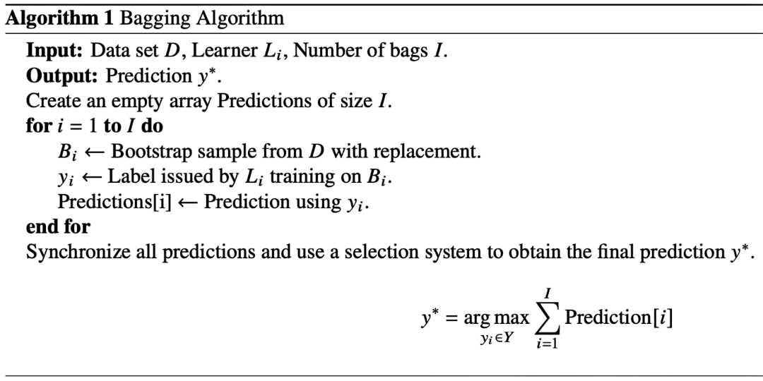
EL : Bagging
Data Set
Bag1
Bag2
Bag3
Model 1
Model 2
Model 3
P1
P2
P3
Aggregation
FP

Slide 10
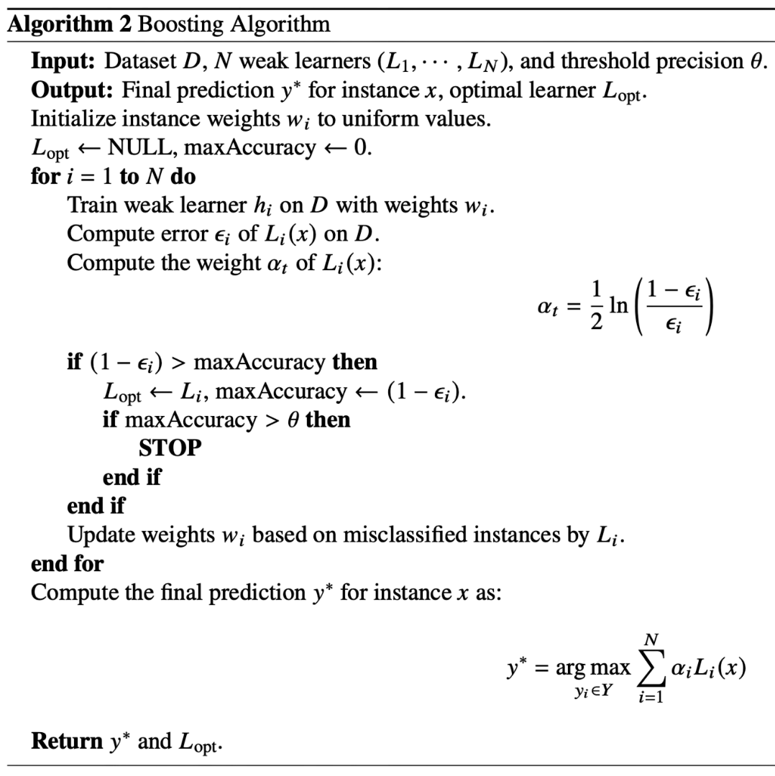
EL : Boosting
Data Set
Model 1
Model 2
Model 3
W1
W2
P1
P2
P3
Aggregation
FP

Slide 11
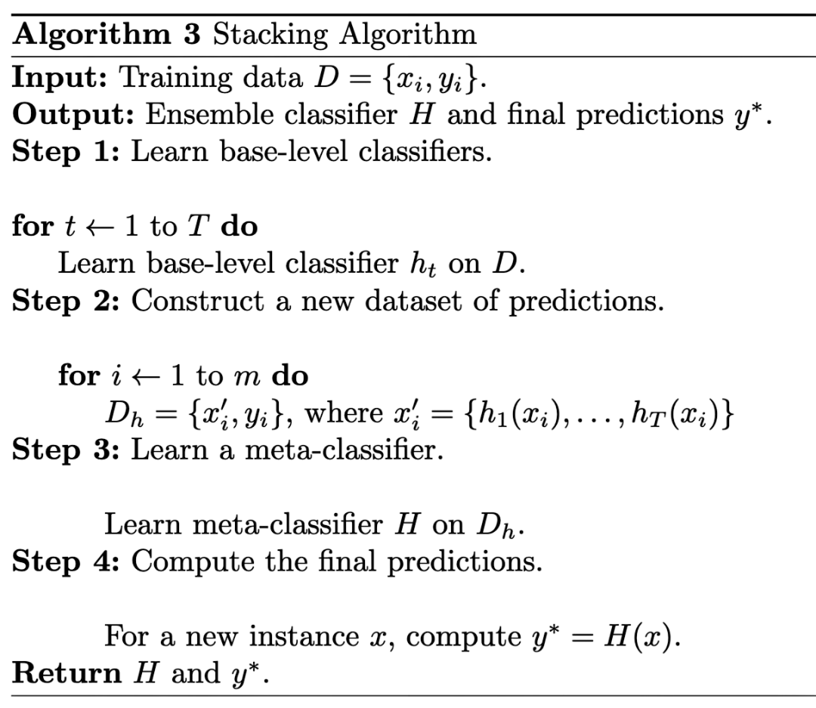
EL : Stacking
Data Set
Model 1
Model 2
Model 3
P1
P2
P3
Meta model integrates outputs
FP

Slide 12

Unite and Conquer for HP Linear Algebra
UC approach involve several iterative
(co-)methods collaborating to solve the same given problem to find the solution more quickly than each of the co-methods individually.
(Re)starting Conditions 1
(Re)starting Conditions 2
(Re)starting Conditions 3
Solving P by M1
Solving P by M2
Solving P by M3
Solution 1
Solution 2
Solution 3
$f$(S₁ᵏ, ..., Sₗᵏ)
Synchronous or Asynchronous Information Exchange
Notes:
UC approach, initially used for Linear algebra, involve several iterative (co-)methods collaborating to solve the same given problem to find the solution more quickly than each of the co-methods individually. these methods share information at the end of each cycle.
This shared knowledge, derived from previous iterations, helps to create improved initial conditions for the next cycle, accelerating convergence and enhancing the quality of the solution.
The success of this method largely depends on the quality of the restarting conditions, which combine the results from multiple methods to optimize the entire process.

Slide 13
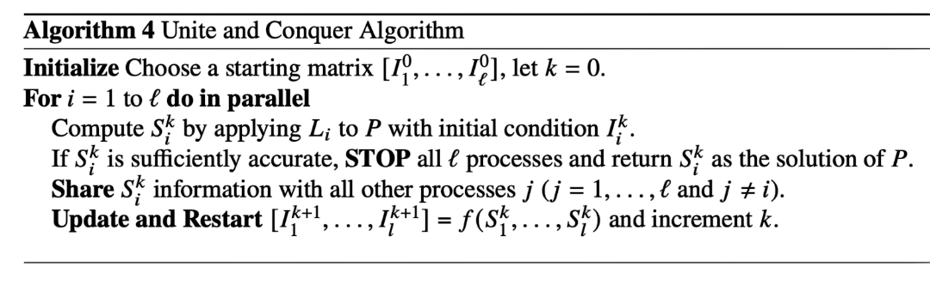
UC Fundamental Principles
1
Multi-Level Parallelism
2
Fault Tolerance
3
(A)-synchronous Communications
4
Heterogeneity of components
5
Load Balancing
. . .

Slide 14
3. Proposed AD Frameworks
UC2B Variants

Slide 15


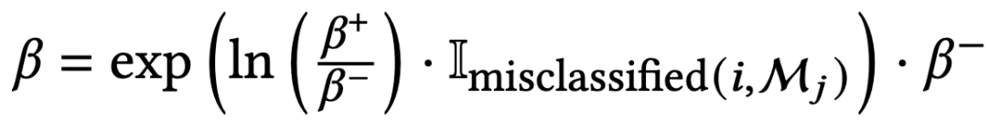
UC2B
Preprocessing Unit
Data Set
Valid set
Double boost
Update conditions
Model 1
Model 2
W1
W2
Model 3
Bag 1
Bag 2
Bag 3
Bag 1
Bag 2
Bag 3
Bag 1
Bag 2
Bag 3
Copy 1
Copy 2
Copy 3
Copy 2
Copy 3
Copy 1
Copy 1
Copy 2
Copy 3
FP/FN
Satisfactory Accuracy Evaluation
Aggregation / Stacking
Sequential
Final Predictions
Notes:
The proposed approach make collaborate several co-methods or machine learning models, each trained on different bags of the dataset in parallel inside. In this first version the co-models are sequential where each one boosts the next by providing the higher weights to the misclassified instances. After the training of all the co-models a synchronisation of all them will be done where they will share the weights of misclassified instances to higher their weights if the stasfied accuuracy is not met , which will lead to a double boost. This process is insured with the restarting function that I defined as shown. And framework is operating on 1 node.

Slide 16
UC2B
Preprocessing Unit
Data Set
Valid set
Update conditions
Fault tolerance
Model A
Model B
Model C
Bag 1
Bag 2
Bag 3
Bag 1
Bag 2
Bag 3
Bag 1
Bag 2
Bag 3
Copy 1
Copy 2
Copy 3
Copy 1
Copy 2
Copy 3
Copy 1
Copy 2
Copy 3
FP/FN
Satisfactory Accuracy Evaluation
Aggregation / Stacking
Parallel synchronous
Final Predictions
Notes:
In this version the co models operates on separate nodes, working in parallel with the others. Which means that we don’t have the insider boost, but we gain a fault tolerance aspect. The same process, after the training of all the co-models a synchronasation will be done, and a check on the valiation set to verify is the needed accuracy is achieved, if not the framework will go for a new boosted iteration thanks to the restarting function that provide higher weights to the FP/FN and repeat until the convergence. This synchronization impact the speed of the framework wehre the faster models should wait for the longer ones.

Slide 17
UC2B
Preprocessing Unit
Data Set
Valid set
Update conditions
Fault tolerance
Asynchronism
Model A
Model B
Model C
Bag 1
Bag 2
Bag 3
Bag 1
Bag 2
Bag 3
Bag 1
Bag 2
Bag 3
Copy 1
Copy 2
Copy 3
Copy 1
Copy 2
Copy 3
Copy 1
Copy 2
Copy 3
FP/FN
Satisfactory Accuracy Evaluation
Aggregation / Stacking
Parallel asynchronous
Final Predictions
Notes:
This limitation was addressed with asynchronous communications integrated to the framework, where …

Slide 18
UC2B
Preprocessing Unit
Data Set
Data1
Data3
Valid set
Data2
Model A
Model B
Model C
Update conditions
Fault tolerance
Asynchronism
Multi level Parallelism
Bag 1
Bag 2
Bag 3
Bag 1
Bag 2
Bag 3
Bag 1
Bag 2
Bag 3
Copy 1
Copy 2
Copy 3
Copy 1
Copy 2
Copy 3
Copy 1
Copy 2
Copy 3
FP/FN
Satisfactory Accuracy Evaluation
Aggregation / Stacking
Multi-parallel asynchronous
Final Predictions
Notes:
A multi level parallelsim is added to the framework in this version where data parallelism is added to scale more …

Slide 19
4.Implementation & Evaluation
Used data set and High-Performance architectures
Approach validation
Calculation efficiency

Slide 20
UNSW-NB15 Dataset
Aspect | Details
Dataset Name | UNSW-NB15
Type | Network-based IDS dataset created at UNSW, Australia.
Data Capture | Captures network traffic in a controlled environment with various operating systems, applications, and attack types.
Labels | 'Normal' or 'Attack' traffic; attacks classified into 10 types.
Research Usage | Extensively used for developing and evaluating network-based IDS.
Total Records | Approximately 2.6 million network flow records over 30 days.
Number of Features | 49 (Basic, Content, time-based, statistical, label-based) features.
Class Distribution | Normal: 70,000 Probe: 4,107 DoS: 115,736 U2R: 52 R2L: 1,126
Notes:
The dataset is a network-based IDS created at UNSW. It captures traffic in a controlled environment with various operating systems, applications, and attack types from different malware families. It is labeled as normal or attack and contains approximately 2.6 million unbalanced records with 49 features.

Slide 21
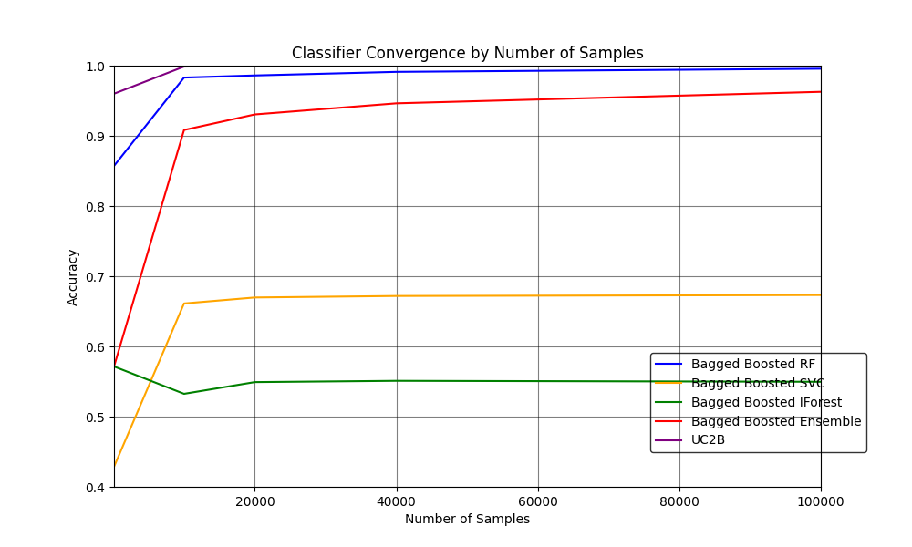
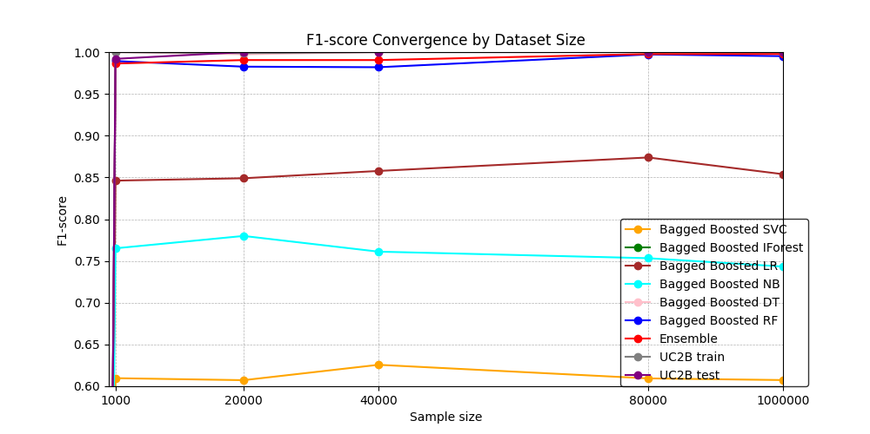
Convergence of serial UC2B
Accuracy with 3 co-methods
F1-score with 6 co-methods
Iforest 0% F1-score, it identifies the majority class.
UC2B identifying both classes, well-balanced performance

Slide 22
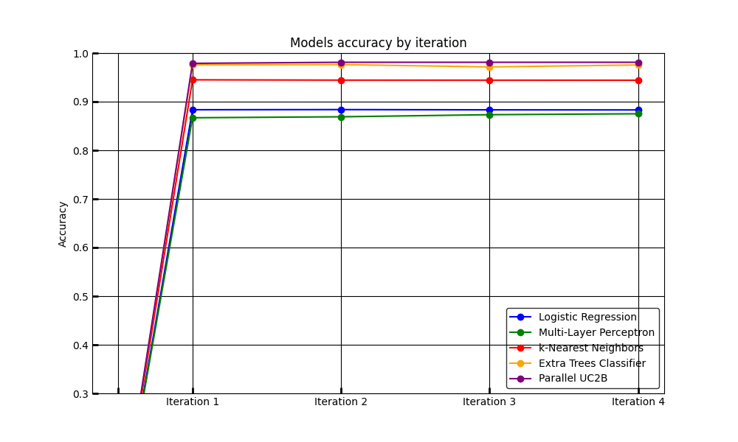
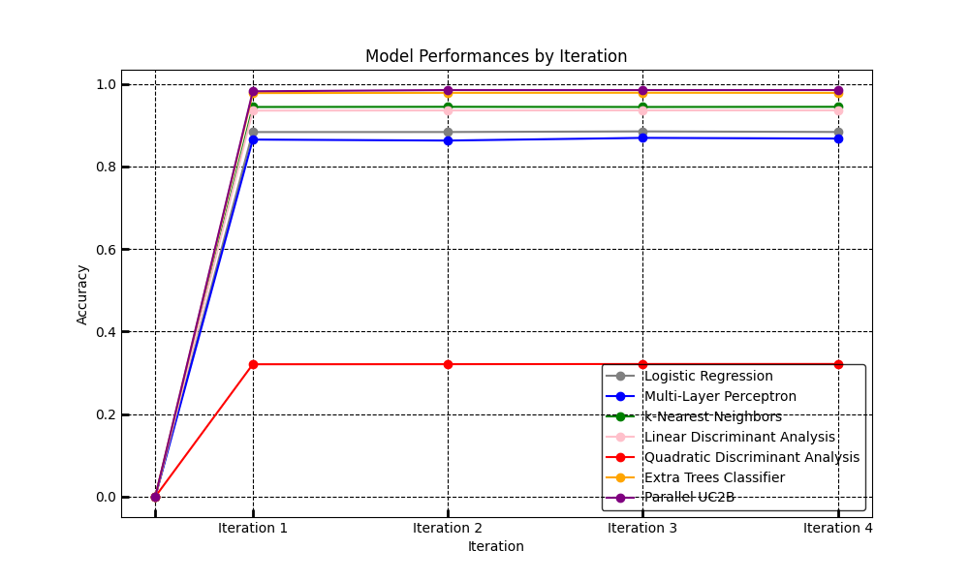
UC2B in Parallel Convergence
Accuracy with 4 co-method
Accuracy with 8 co-methods
Accuracy from 97.88% with 4 co-methods to 99.4% with 8

Slide 23
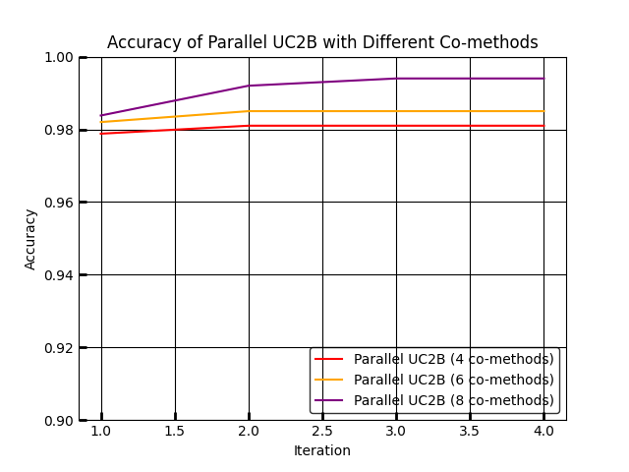
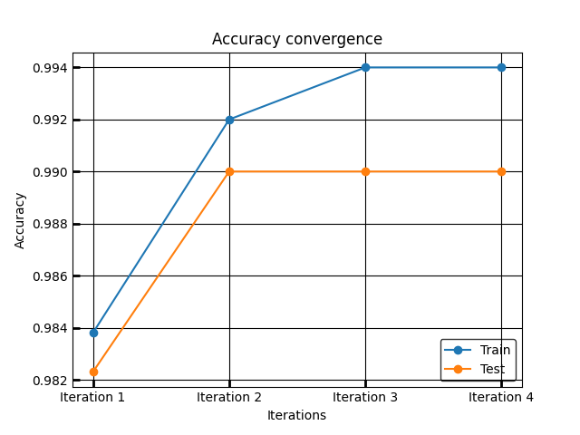
UC2B in Parallel Convergence
Accuracy with 8 co-methods
UC2B’s accuracy on train and test
Co-methods heterogeneity improves accuracy
No over/under-fitting

Slide 24
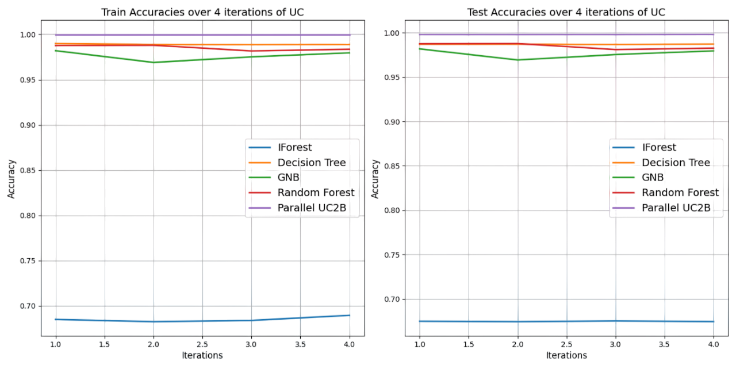
UC2B in Parallel ‘Synchronous’
UC2B Vs models accuracy convergence on train and test
Data parallelism, more copies of models

Slide 25
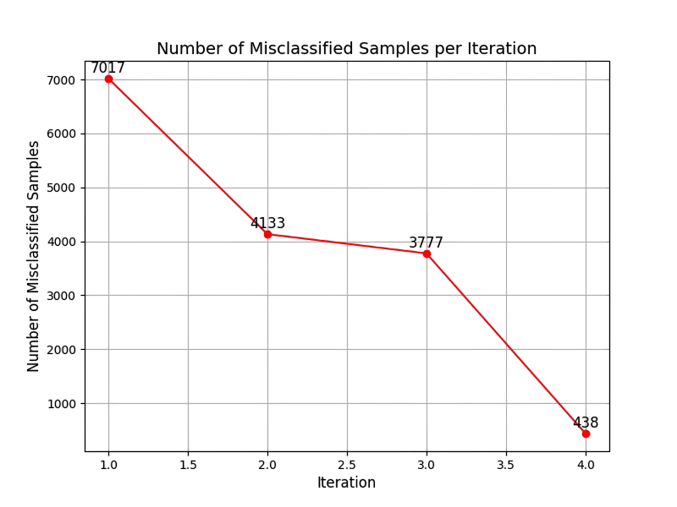
UC2B in Parallel ‘Synchronous’
 | Iteration1 | Iteration2 | Iteration3 | Iteration4
UC2B’s Train Accuracy | 0.9999 | 0.9999 | 0.9999 | 0.9999
UC2B’s Test Accuracy | 0.9979 | 0.9979 | 0.9979 | 0.9980
UC2B’s Confidence Score | 0.9980 | 0.9980 | 0.9980 | 0.9981
Confidence Score of UC2B
Confidence Score = 1 − |Train Accuracy − Test Accuracy|
Impact of the restarting function
UC2B’s Behavior with misclassified instances

Slide 26
UC2B in Parallel ‘Asynchronous’
Model | Accuracy |  | Precision |  | Recall |  | F1-score |  | Confidence Score
Data set | Train | Test | Train | Test | Train | Test | Train | Test | Accuracy | Precision
Boosted Bagged LR | 0.979 | 0.976 | 0.414 | 0.573 | 0.021 | 0.033 | 0.041 | 0.062 | 0.997 | 0.841
Boosted Bagged DT | 0.990 | 0.988 | 1.000 | 0.942 | 1.000 | 0.929 | 1.000 | 0.935 | 0.998 | 0.942
Boosted Bagged GNB | 0.977 | 0.969 | 0.482 | 0.455 | 0.638 | 0.633 | 0.549 | 0.529 | 0.992 | 0.973
Boosted Bagged RF | 0.980 | 0.978 | 1.000 | 0.935 | 1.000 | 0.961 | 1.000 | 0.948 | 0.998 | 0.935
Parallel UC2B | 0.999 | 0.998 | 1.000 | 0.978 | 1.000 | 0.981 | 1.000 | 0.971 | 0.999 | 0.978
UC2B is robust, accurate, and well-balanced in its predictions
Successfully generalizing from the training data to unseen data without overfitting
33

Slide 27
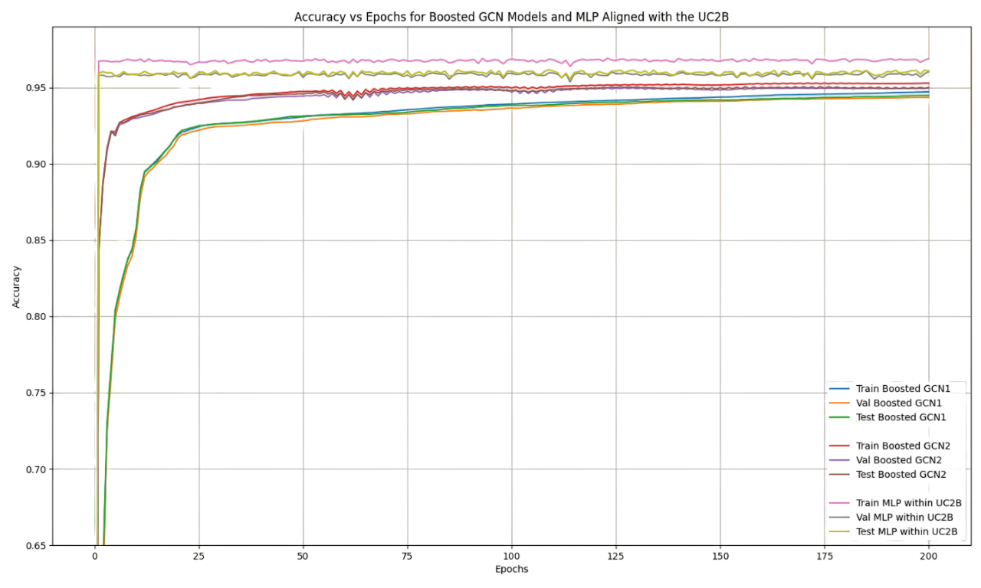
UC2B with GCNs
Loss: Cross entropy – Negative log-likelihood
Activation: ReLU – Leaky ReLU

Slide 28
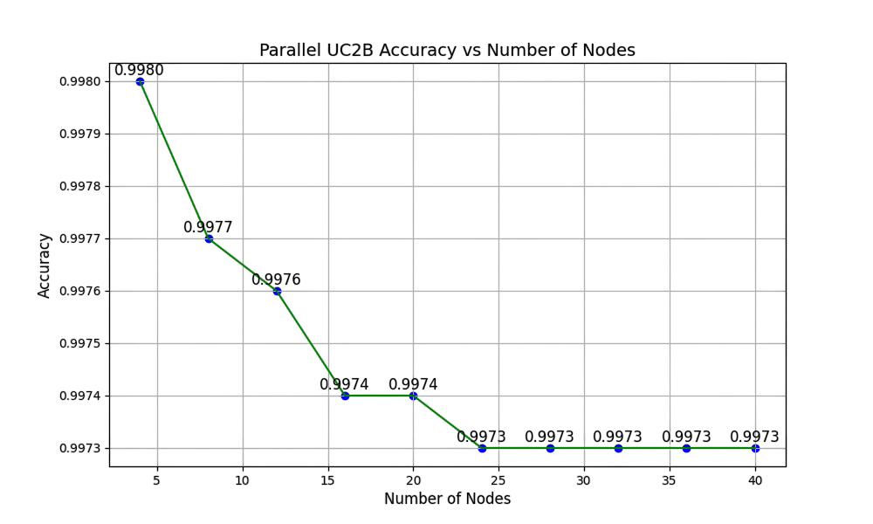
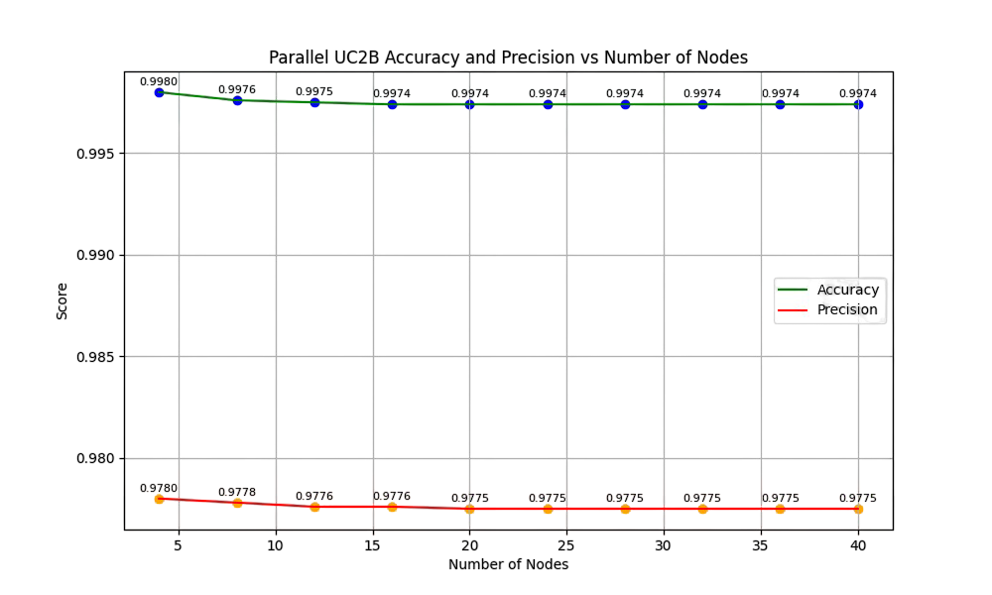
Synchronous Vs Asynchronous
Accuracy and precision stability on Fugaku
Stability on 99.73%
Accuracy stable on 99.74%, precision stable on 97.75%

Slide 29
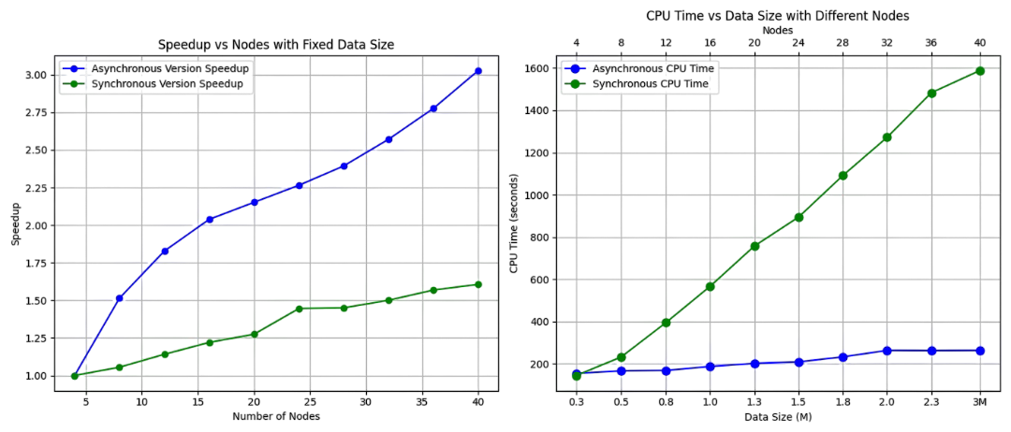
Synchronous Vs Asynchronous
Strong Scalability
Weak Scalability
Speedup less than 2x, 11x weak scale on Fukagu
3x speedup, less than double time from 300k to 3M samples

Slide 30
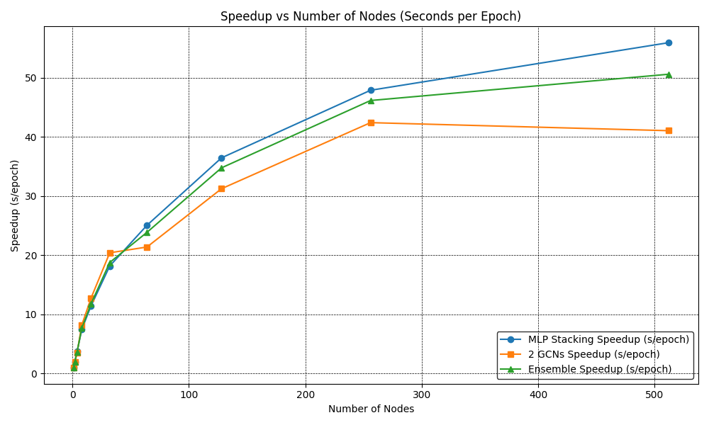
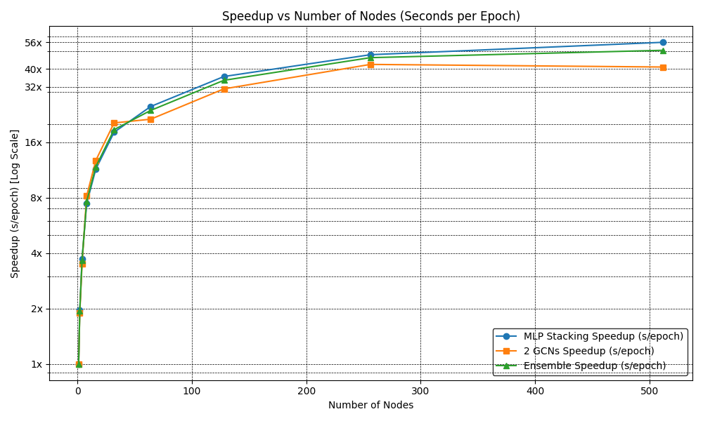
Graph Scale on Fugaku
Speedup per epoch
Speedup of the entire execution time
Speedup of the ensemble per epoch 50x, GCNs 41x, MLP 54x
Speedup of the ensemble for 200 epochs 49x, GCNs 41x, MLP 52x
ET per epoch 4 seconds on 1 node and 0.08 seconds on 512 nodes
ET total time on 1 node 867 seconds, 512 nodes 17 seconds

Slide 31
Findings and Interpretation
1
Approach Validation
99.5% UC2B in sequence 97% Synchronous parallel UC2B and graph 99.74% Asynchronous and diverse co-methods
2
Fast Detection
From 10 days to 263 seconds Adapted to small resources 26 minutes, HP resources 4.5 minutes, 17 seconds with graphs Adapted to continue training applications
3
Scalable Detection
Weak and strong scale Data scalability
Speedup over 50x
40

Slide 32
6. Conclusion
Contributions summary
Perspectives

Slide 33
Contributions Summary and Perspectives
Innovative integration of ML inspired by UC.
Multi-level Parallelism.
Heterogeneity of components, fault tolerance and load balancing potential.
Natural coarse grain parallelism and asynchronism.
Extension to spectral methods
Global structure insights : connectivity and cluster ability through eigenvalues.
Synergy with advance graph-base models.
Generalization to broader domains
Domain applications: supports healthcare, finance, IoT (real-time fault prediction).
Scalable and Precise: refine methodologies.

Slide 34
Workshop Questions
What missing interoperability layers (software, standard, or abstraction) would most accelerate convergence between traditional HPC linear algebra workflows and today’s extreme-scale AI workloads.
A standard coupler or interface would make it easier. For example, to insert anomaly detection models, like spotting cyberattacks in HPC system logs, into existing simulation pipelines.
Looking ahead to 2030, do you expect the principal bottleneck for extreme-scale AI to be data, algorithms, resilience or energy, and how does that prediction shape your research priorities today
Energy. it shapes how we design scalable AI workflows today: fewer communications, smarter parallelism, and energy-aware training.
Given the different developments in architecture processors for AI and “computational science”, do you think we'll see a convergence or divergence of roadmaps?
We may see hardware divergence, but a strong software layer can bridge AI accelerators and HPC systems. In practice, we already adapt to what's available.

Slide 35

Another Brain's Inspiration
Founded in 2017 by Bruno Maisonnier, founder of Aldebaran Robotics & creator of humanoid robots NAO and Pepper.
Supported by the French government.
AnotherBrain creates a new generation of AI: ORGANIC AITM
Bio-inspired, Human-friendly, Embedded (without big data)
Frugal in energy, Explainable
Trusted AI is, by definition, human-friendly and powerful.

Slide 36
Thanks for your attention

Slide 37
Additional Slides

Slide 38
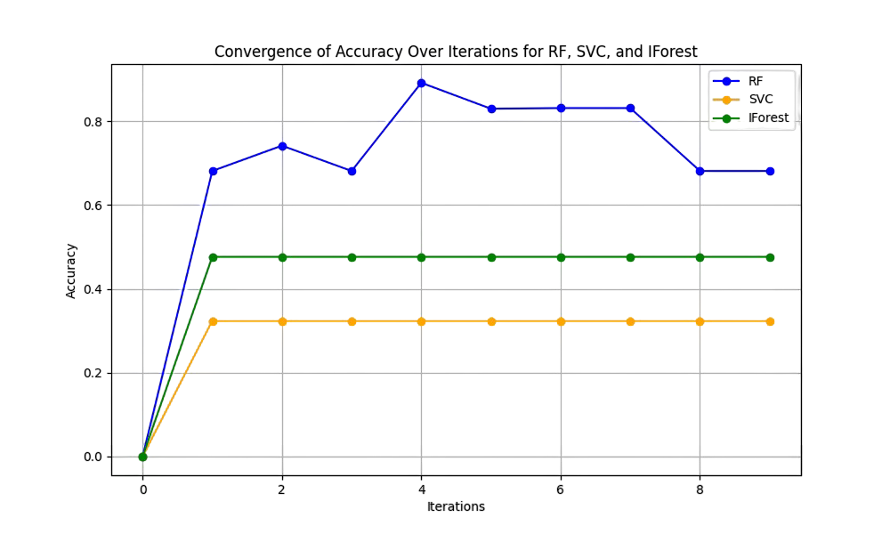
Motivation

Slide 39
Base Co-Models
Co-methods are co-models
Supervised Learning models
RF, SVM, LR, GNB, DT, ETC, KNN…
Unsupervised Learning models
K-means, IForest, Elliptic Envelope, PCA…
Semi-supervised Learning models
Co-training, Semi-Supervised SVM, Self-training…
Deep Learning and graph models
Multi-Layer Perceptron, Graph Convolutional networks

Slide 40
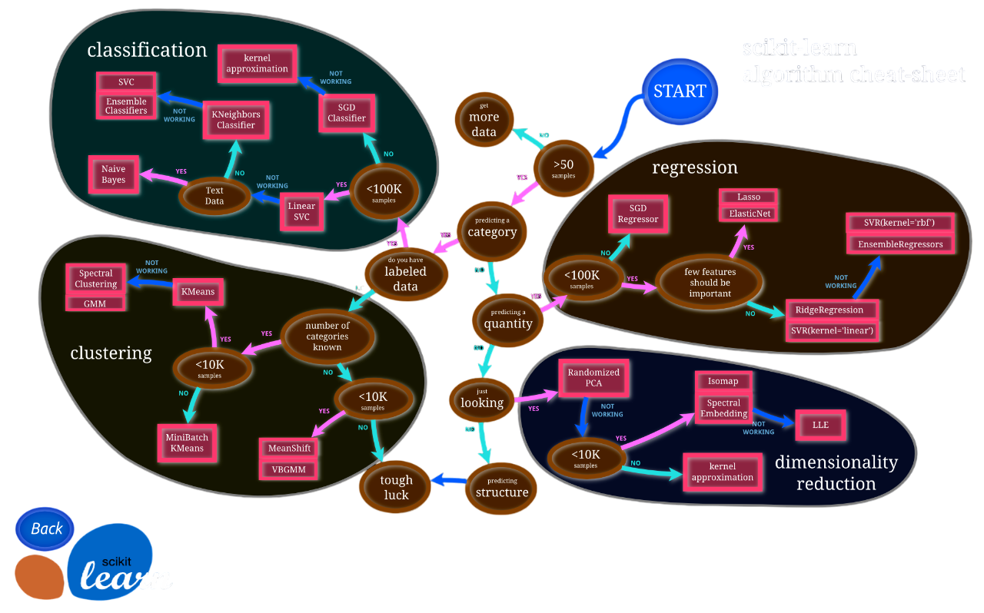
Components Heterogeneity

